Slide 1
ENGLISH COMPOSITION & COMPREHENSION SS150
COURSE INSTRUCTOR: NAZIA IMAM
NAZIA.IMAM@NU.EDU.PK
LECTURER
DEPARTMENT OF SCIENCES AND HUMANITIES

Slide 2
COURSE DESCRIPTIONS
This course is designed to develop skills in speaking, listening, reading and writing, and studying communicative functions of the target language. Emphasis is on skill acquisition through the use of select reading material from different banks of authentic and non-authentic texts. Through understanding the global, inter relational nature of skills, students are enabled to retain and apply what they have learnt. It will also orient students to the semantic and socio/psycho-linguistic dynamics of language.

Slide 3
COURSE OBJECTIVE
The course will acquaint students with more concise, lucid, and correct expression of English; to provide model forms of communication skills with special stress on phonetics and phonology. The aims are to: achieve proficiency in language use, develop skills in listening comprehension, improve reading efficiency, use the conventions of standard written English with skill and assurance, build-up vocabulary, and summarize clearly and accurately the ideas of others etc. It will illustrate the force and effectiveness of simple and direct English. The course is intended to be interesting in itself.

Slide 4
MARKS DISTRIBUTION:
Particulars | % Marks
1. Quiz | 5%
2. Assignments | 5 %
3. Class Participation Activities | 3 %
5. Final Project | 5 %
5. Class Performance | 2 %
6. Mid-Terms | 30 %
7. Final Exam | 50 %
Total:- | 100

Slide 5
Attendance
Class timing
Lab work
Class activities

Slide 6
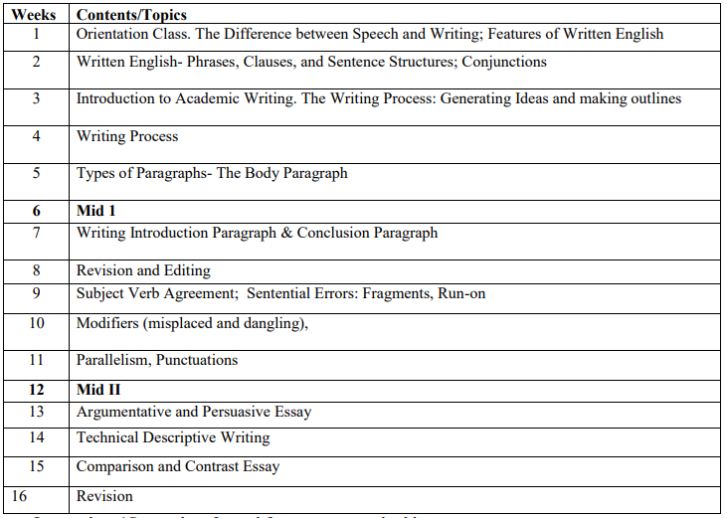

Slide 7
CLASS RESOURCES
www. https://classroom.google.com/
English Composition & Comprehension, Fall 2020
Group code: fjm6v24
Section 1D: c6wrkiv
Section 1F: au2t2cn

